Slide 1
Tourist Attractions vs. Facilities
Practice

Slide 2
FACILITIES VS. ATTRACTIONS
monument
natural beauties
festival
museum
aquarium
botanical garden
observatory
castle
wi-fi
reception
indoor/outdoor pool
room service
tennis court
supermarket
hair-dresser
shuttle service

Slide 3
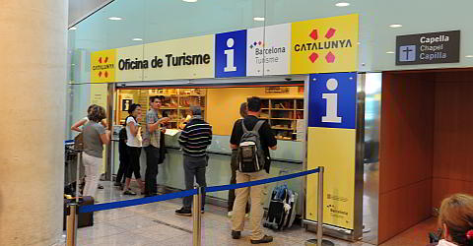
An Enquirer at Tourist Information Centre (TIC)
to enquire, inquire /ɪnˈkwʌɪə/- ask information from sb.

Slide 4

Send us your enquiry = upit

Slide 5
1. p. 122, Listen to these enquiries made at Tourist Information Centre in Sydney. Task 1: in column 1 note down what the enquirer is looking for.
WHAT THE ENQUIRER IS LOOKING FOR | WHERE TO GO IN SYDNEY | TIC REPLY | WHERE TO GO IN YOUR COUNTRY/CITY

Slide 6
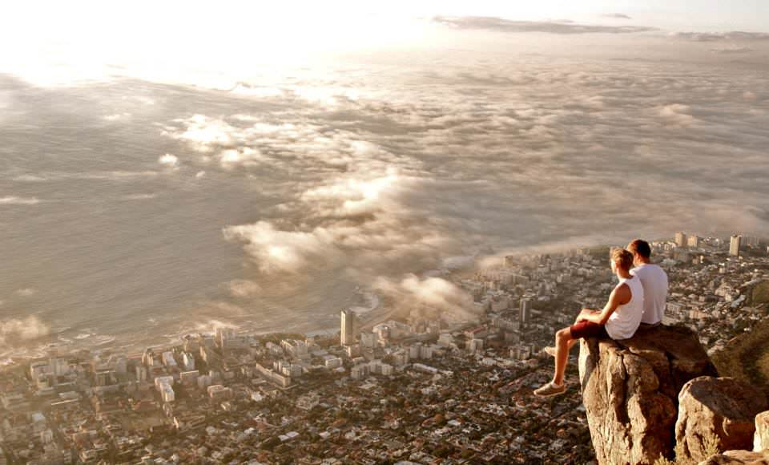
Panoramic views scenic, far-reaching, usu. from a high position such as a bridge, a tower, a scyscraper, a fortress or a castle

Slide 7
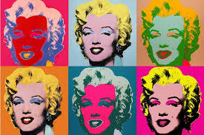
Paintings by Andie Warhol
Exhibition = Display

Slide 8
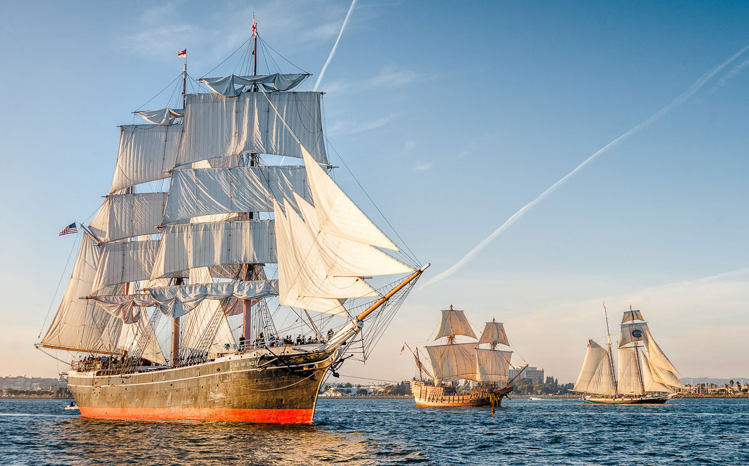
Battleships
Old Historic Ships

Slide 9
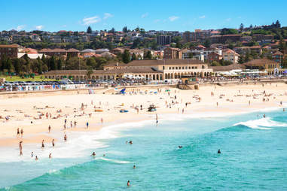
swim, relax, hang out (spend time with sb.), sunbathe/ˈsʌn.beɪð/
Bondi Beach /bondai bi:tᶘ/

Slide 10
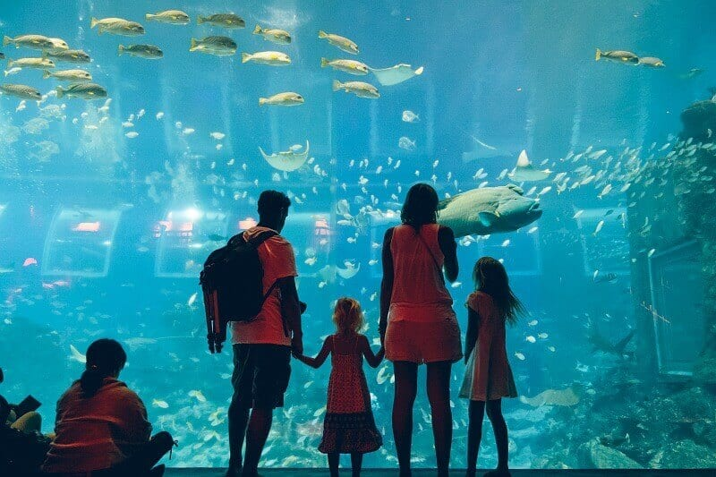
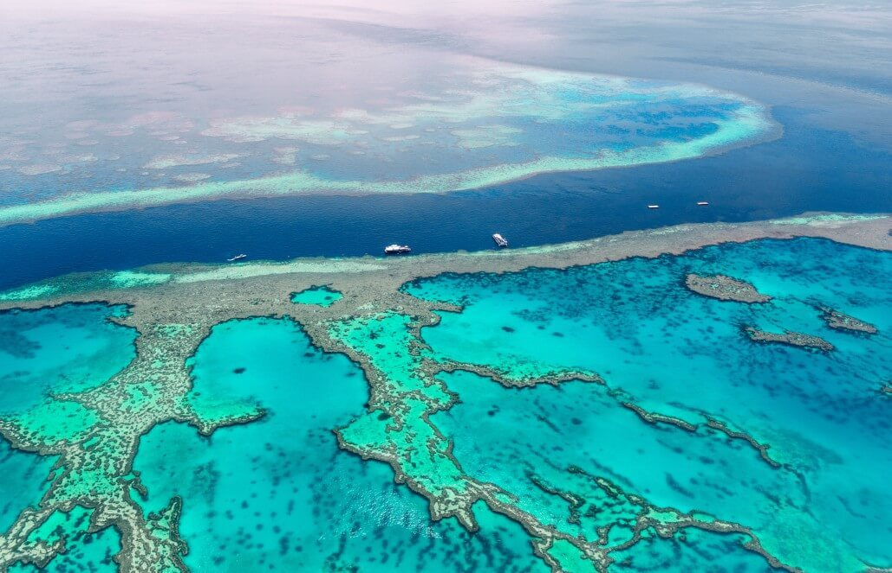
Sthg. educational for children, sea life, sharks, crocodiles
A great display (exhibition) on Great Barrier Reef (Serb. Veliki koralni greben)

Slide 11
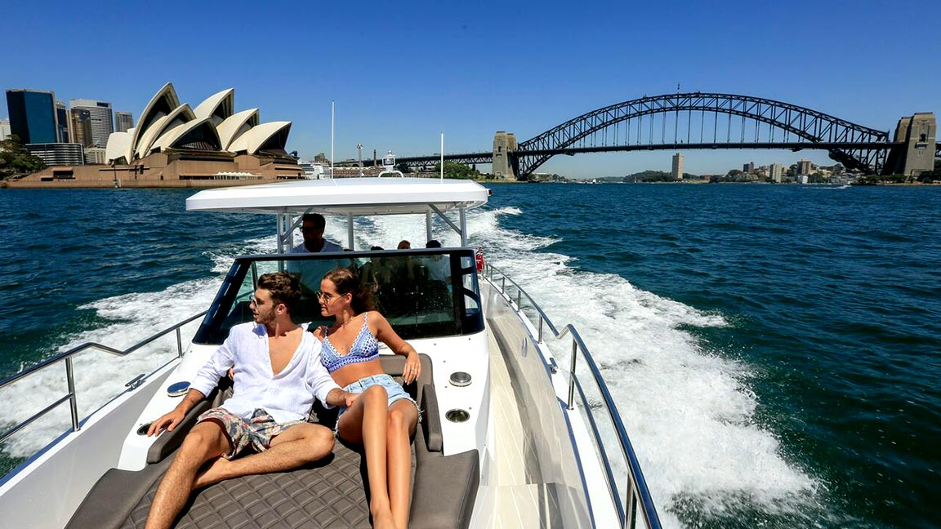
I’m interested in seeing all the famous sights: The Bridge, The Opera House

Slide 12
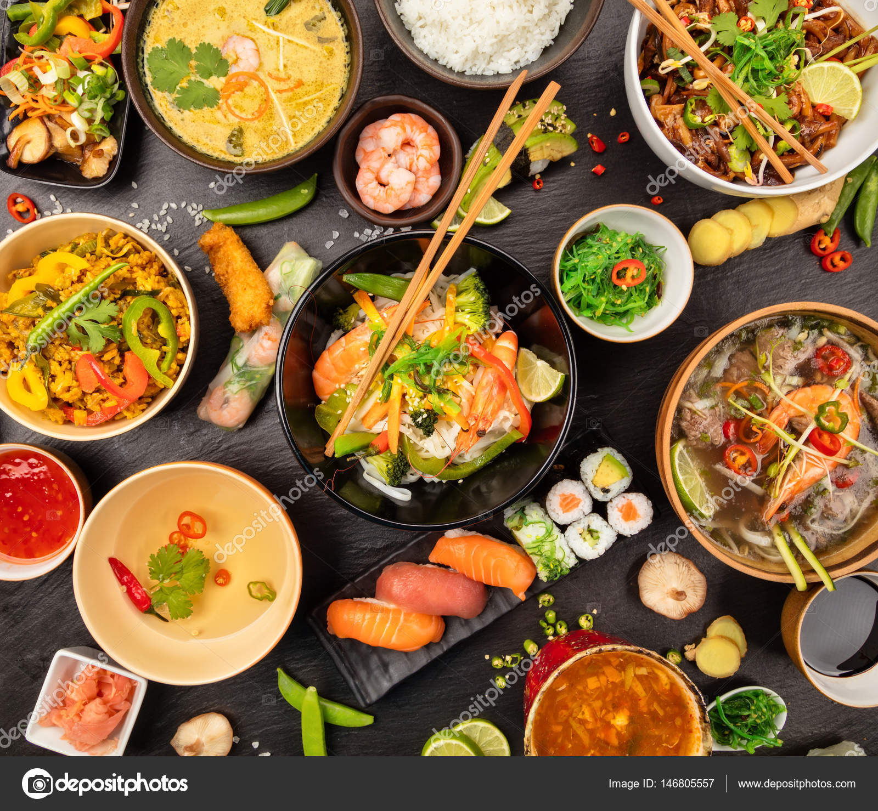
ethnic side of the city with different kinds of food

Slide 13
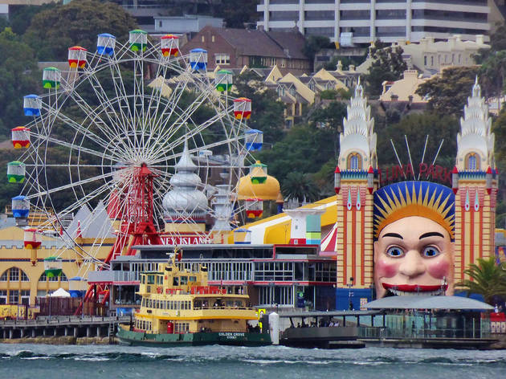
Fun, rides and roller-coasters
Luna Park visit: https://www.lunaparksydney.com

Slide 14
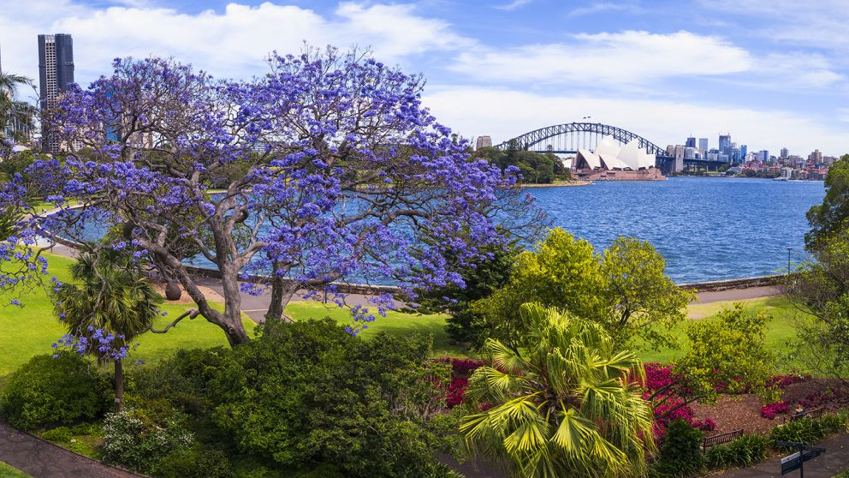
The best place to get away from the hustle&bustle of the city (Serb.gradska vreva), some greenery and fresh air.
visit: https://www.rbgsyd.nsw.gov.au/

Slide 15
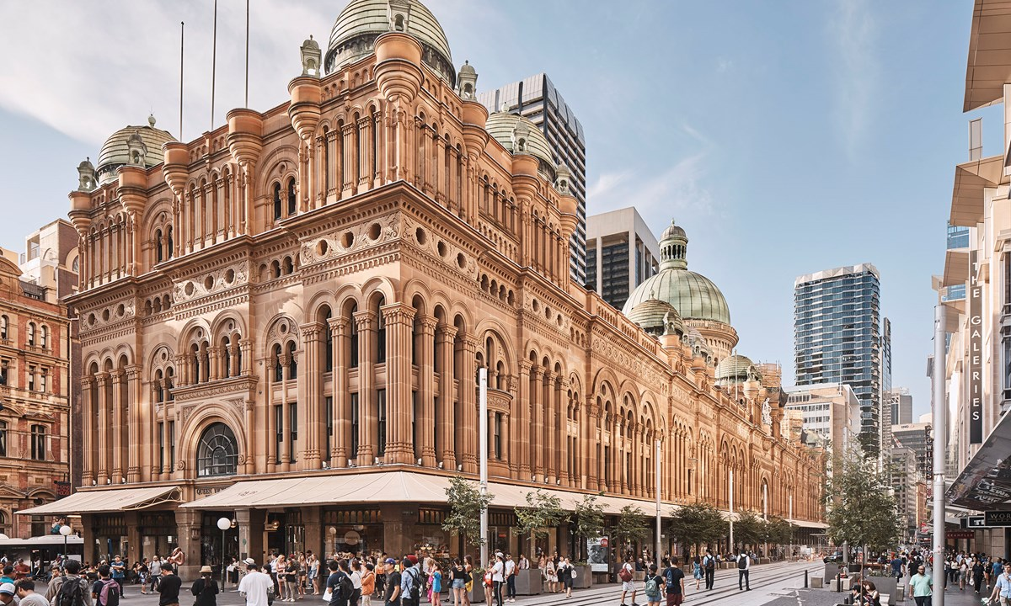
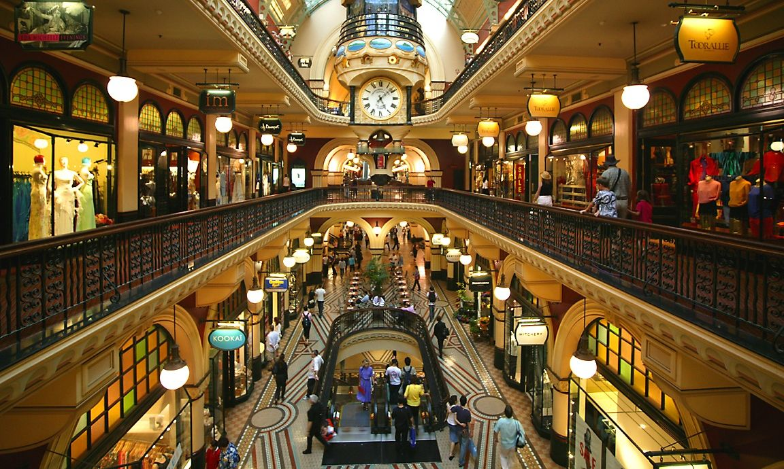
old-fashioned (vintage) indoor shopping mall with all the top designer shops and some bars and restaurants

Slide 16
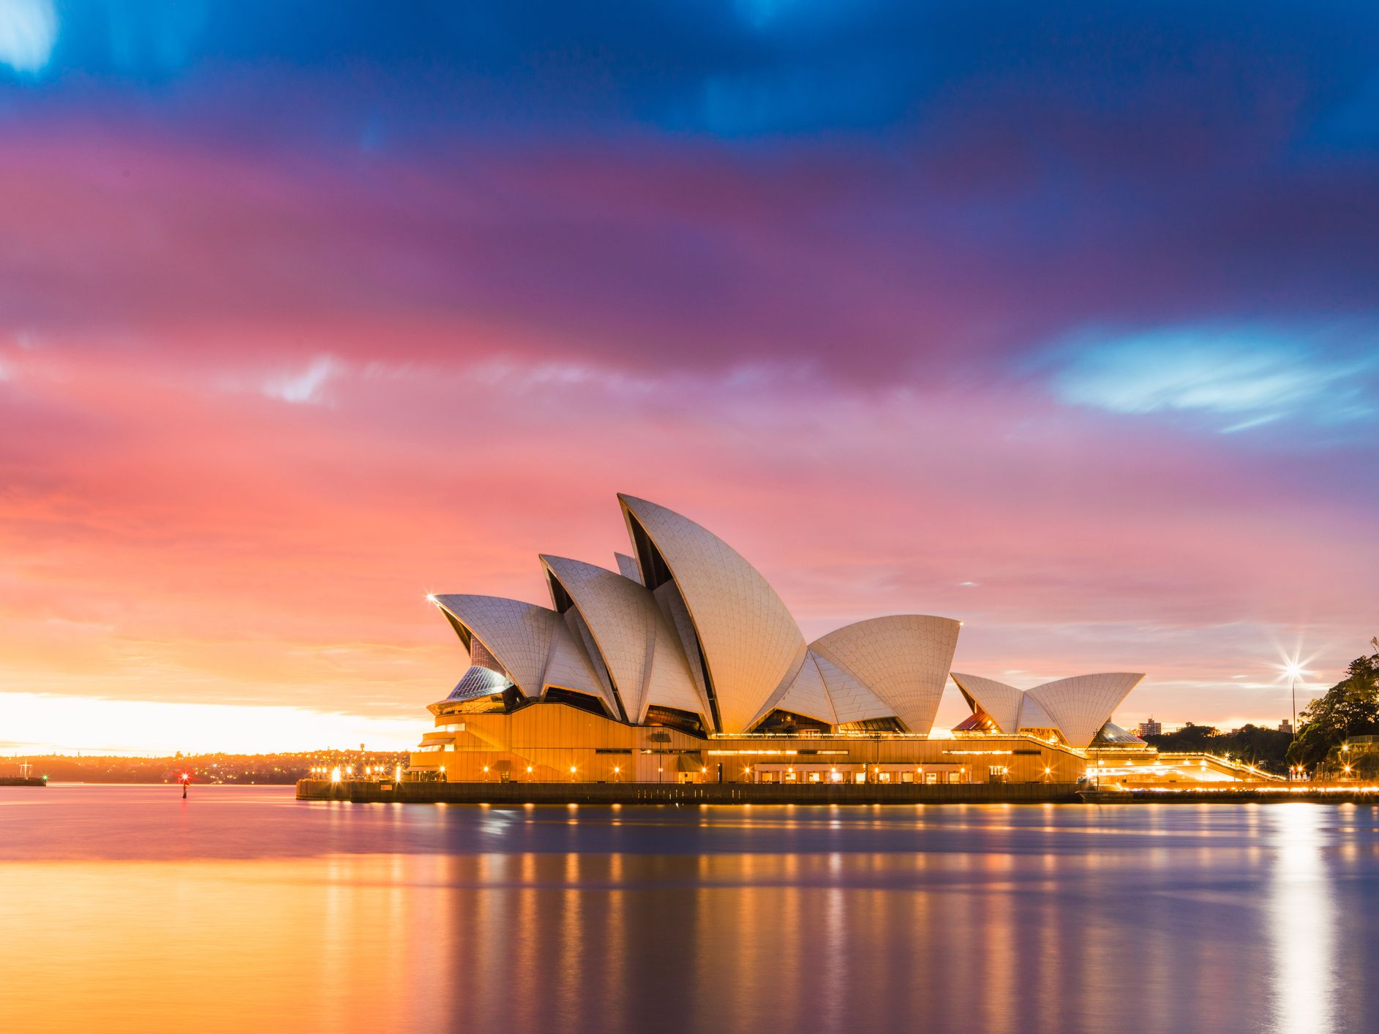
Sydney’s Top Fifteen Tourist Attractions
Sydney Tower
Sydney Opera House
Sydney Harbour
Royal Botanical Gardens
Art Gallery of New South Wales
Taronga Zoo
Bondi Beach
National Maritime Museum
Aquarium
Chinese Garden and China Town
Sydney Observatory
Sydney Harbour Bridge
Luna Amusement Park
Museum of Contemporary Art
Queen Victoria Building

Slide 17
2. page 123, Look at the list of Sydney’s top 15 tourist attractions (SLIDE 16). Where do you think would be the best place to suggest for each of the enquirer to visit? TASK 2, write your suggestions in column 2.
WHAT THE ENQUIRER IS LOOKING FOR | WHERE TO GO IN SYDNEY | TIC REPLY | WHERE TO GO IN YOUR COUNTRY/CITY

Slide 18
3. p. 123, Listen to the second part of the tape and in each case note down which place the Sydney Tourist Information Centre is recommending. TASK 3, write the number in column 3 of the table.
WHAT THE ENQUIRER IS LOOKING FOR | WHERE TO GO IN SYDNEY | TIC REPLY | WHERE TO GO IN YOUR COUNTRY/CITY

Slide 19
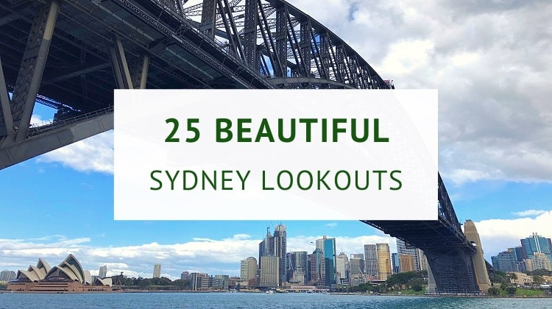
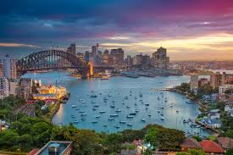
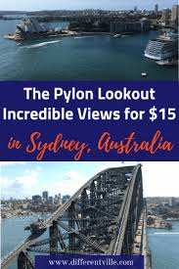
outstanding (breathtaking, stunning) 360 degree view of the city lookout (Serb. osmatračnica)

Slide 20
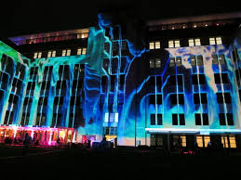
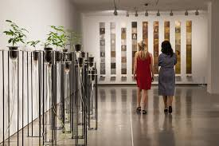
MCA Museum of Contemporary Art

Slide 21
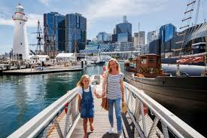
National Maritime Museum
(related to the sea); indoor and outdor exhibitions are well worth visiting
visit: https://www.sea.museum/

Slide 22
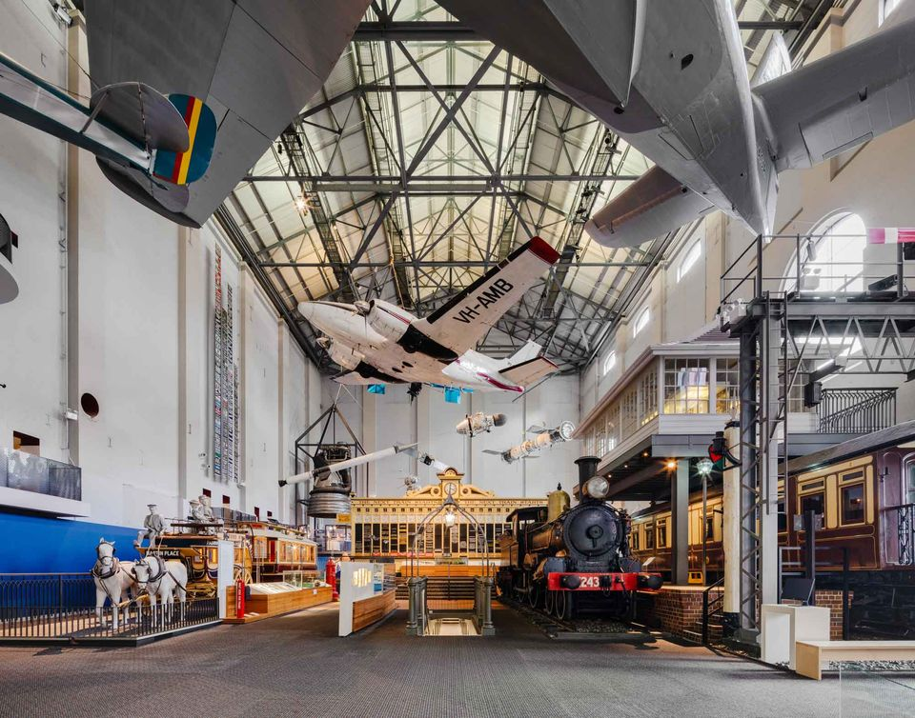
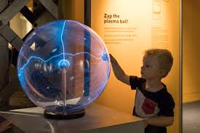
Powerhouse Museum (power=electricity) with hands-on (=interactive) activities for children

Slide 23
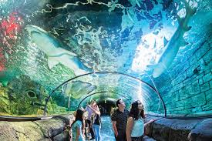
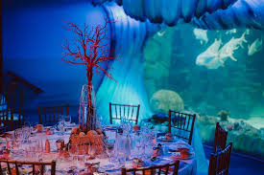
Aquarium visit: https://www.sydneyaquarium.com.au

Slide 24
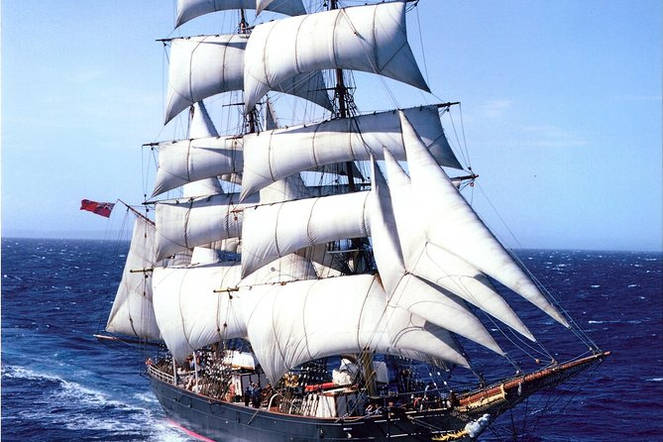
I recommend one of the old square rigs (Serb.sa ukrštenim jedrima)

Slide 25
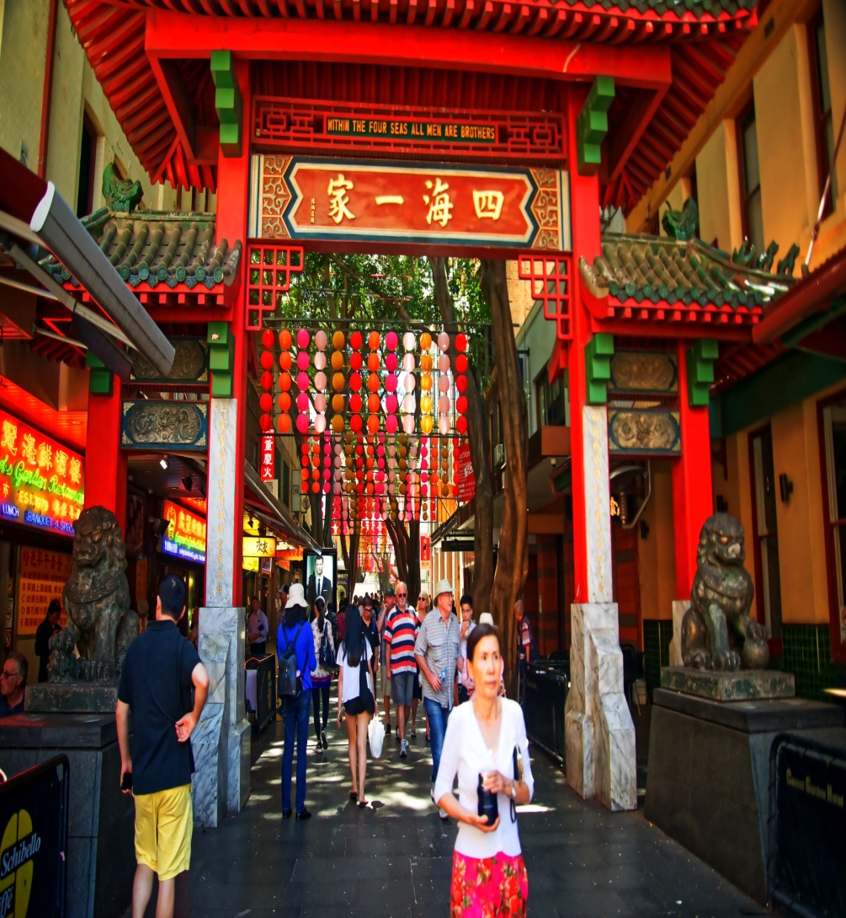
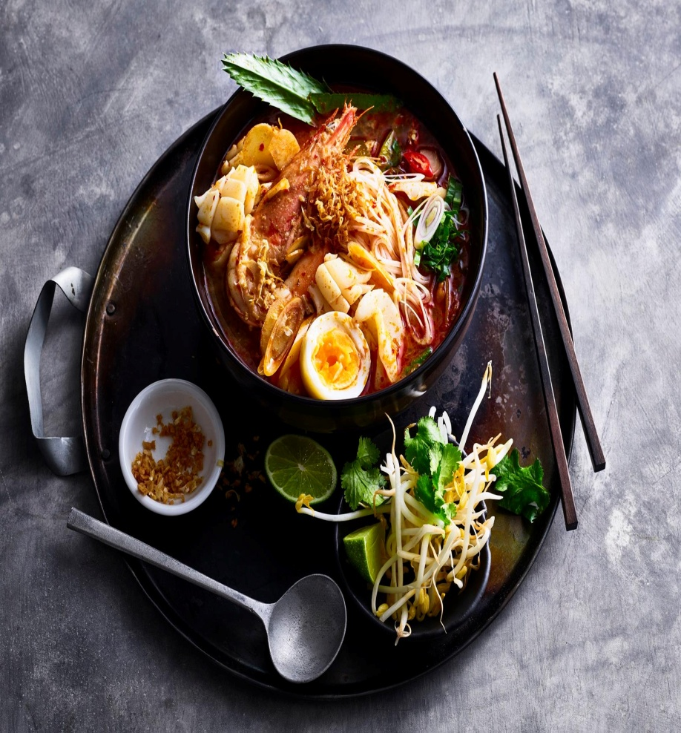
Chinatown (Serb. Kineska četvrt)
Thai cuisine

Slide 26
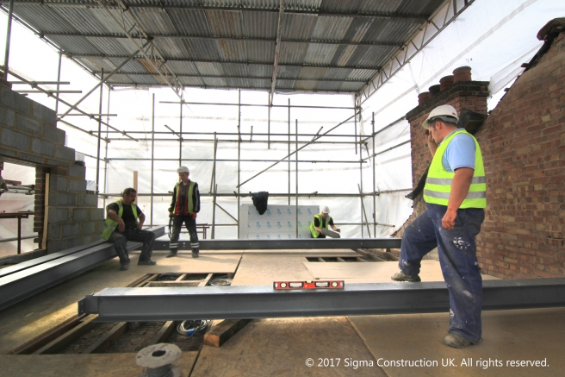
Restored (refurbished, redecorated) and modernized (Serb.renoviran) luna park

Slide 27
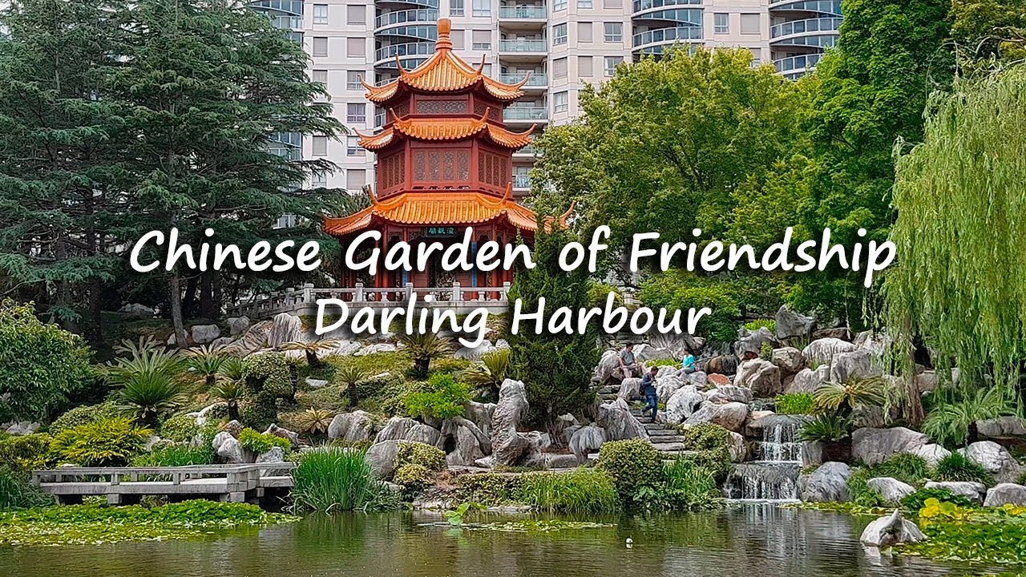
Chinese Garden

Slide 28
4. p. 123,. How would you answer the same enquiries for your own town or city? TASK 4, Write the names and places for your town/city/country in column 4 of the table.
WHAT THE ENQUIRER IS LOOKING FOR | WHERE TO GO IN SYDNEY | TIC REPLY | WHERE TO GO IN YOUR COUNTRY/CITY

Slide 29
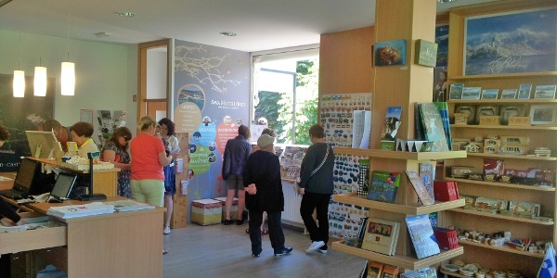
5. Page 123, Task 4, With partner/friend, role-play short conversations in the tourist information centre

Slide 30
Look at the phrases in Unit 3, page 33 to help you
Examples
I suggest going on a river cruise around the Belgrade Fortress
You should definitely rent a car.
If I were you, I’d try local dishes.
For some hands-on activities Nikola Tesla Museum is well worth visiting
Why don’t you take a break
How about sightseeing on an open-top bus

Slide 31
Possible answers
WHAT THE ENQUIRER IS LOOKING FOR | WHERE TO GO IN SYDNEY | TIC REPLY | WHERE TO GO IN YOUR COUNTRY/CITY
PANORAMIC VIEWS | OPERA HOUSE, HARBOURBRIDGE TOWER | 9, 5, 10 | AVALA TOWER KALEMEGDAN FORTRESS
ANDY WARHOL’S PAINTINGS | ART GALLERY OF NEW SOUTH WALES, MUSEUM OF CONTEMPORARY ART | 7 | MUSEUM OF CONTEMPORARY ART
OLD HISTORIC SHIPS IN THE HARBOUR | SYDNEY HARBOUR NATIONAL MARITIME MUSEUM | 1 | THE CITY PORT
SUNBATHE&RELAX | BONDI BEACH | 15 | ADA CIGANLIJA
SEA LIFE DISPLAY | AQUARIUM TARONGA ZOO | 2 | AQUARIUM MUSEUM OF NATURAL HISTORY THE ZOO
ALL THE FAMOUS SIGHTS BOAT TRIP | BOOK A GUIDED TOUR | 11 | TOUR ON AN OPEN-TOP BUS THE DANUBE RIVER CRUISES
ETHNIC SIDE, DIFFERENT KIND OF FOOD | CHINESE GARDEN AND CHINATOWN | 3 | SKADARLIJA for national cuisine
FUN&EXCITEMENT RIDES; ROLLERCOASTER | LUNA AMUSEMENT PARK | 6 | THE BELGRADE FAIR
GET AWAY FROM THE BUSTLE OF THE CITY | CHINESE GARDEN ROYAL BOTANICAL GARDEN | 12, 3 | JEVREMOVAC BOTANICAL GARDEN KOŠUTNJAK
INDOOR SHOPPING MALL | QUEEN VICTORIA BUILDING | 8 | UŠĆE

